Slide 1

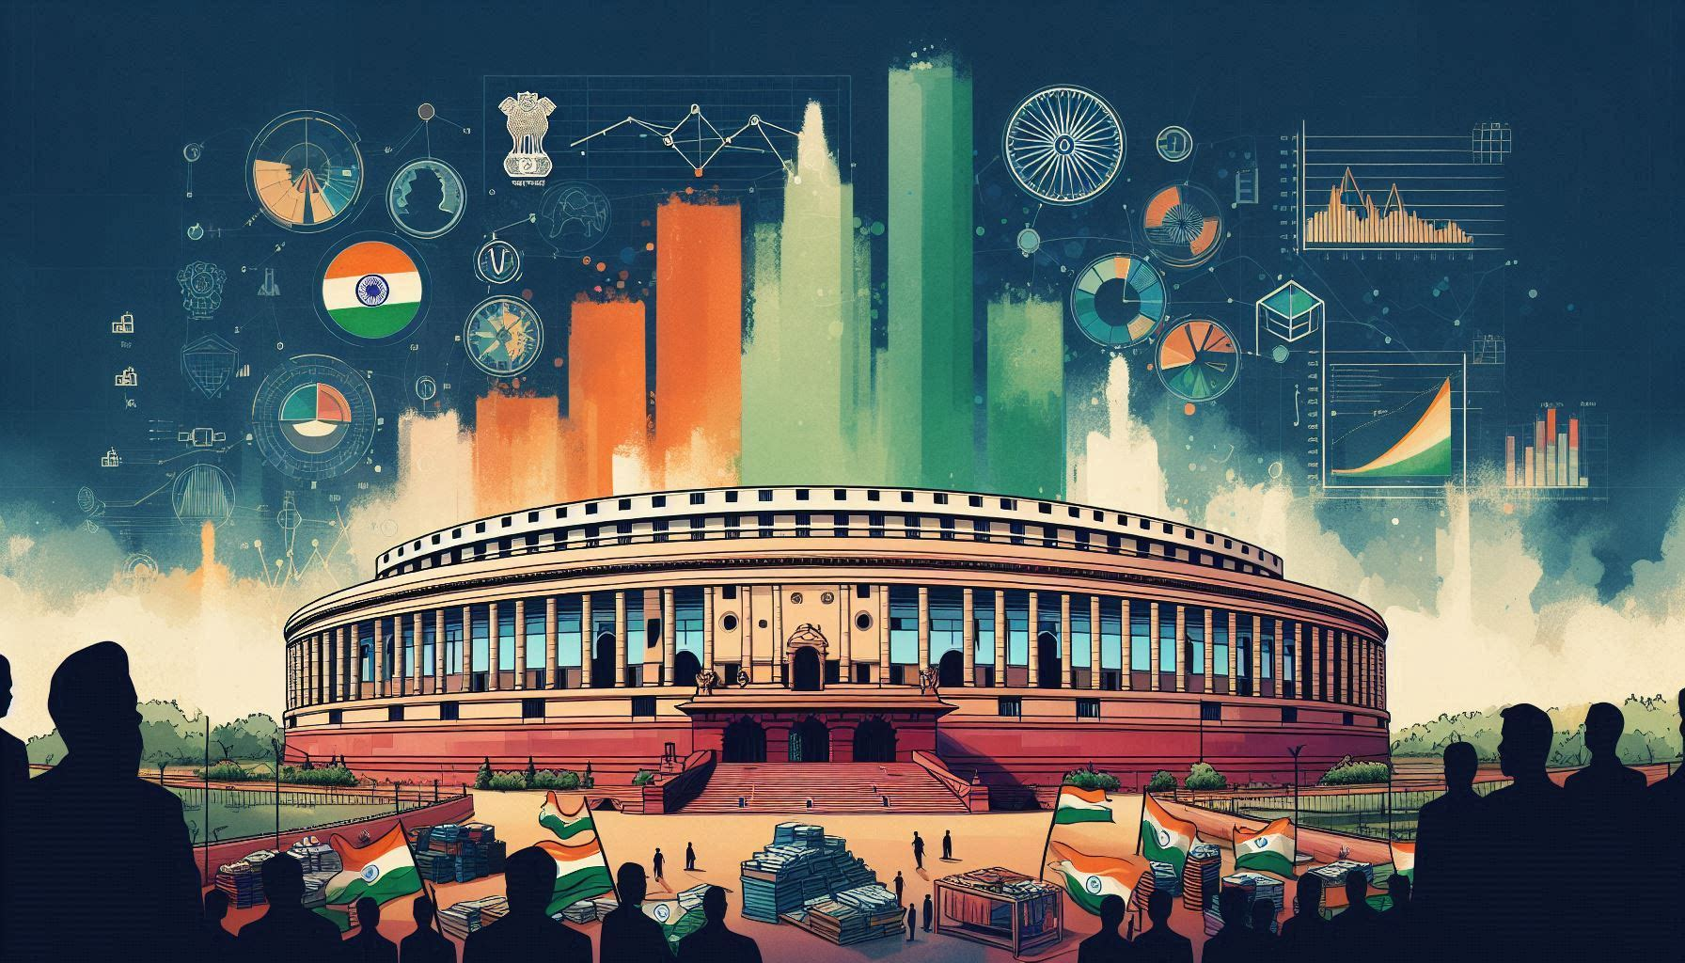
Insights from 2014 & 2019 Lok Sabha Elections Data
Created by : Aniket Prakash Khade

Slide 2
Agenda
Problem statement
Data overview & tools used
Primary Analysis
Secondary Analysis
Recommendations

Slide 3
Problem Statement
AtliQ Media is a private media company and they wanted to telecast as show on Lok Sabha Elections 2024 in India. Unlike other channels they do not want to have a debate on who is going to with this election, they rather wanted to present insights from 2014 & 2019 elections without any bias and discuss less explored themes like voter turnout percentage in India.
AtliQ Media

Slide 4


Regarding Data & tools used
Few states have same constituency names so we created a column for unique parliamentary constituency.
In 2014 Andhra Pradesh went under bifurcation. For simplicity, all constituencies from that year are attributed to Telangana state rather than Andhra Pradesh.
Please note : In 2014 dataset data of Odisha & Chhattisgarh is missing.
Used MySQL for querying & analysing data & Power BI for creating visuals/charts.

Slide 5
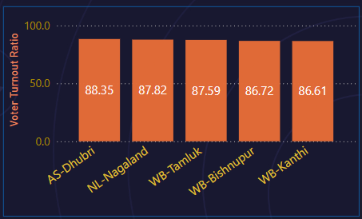
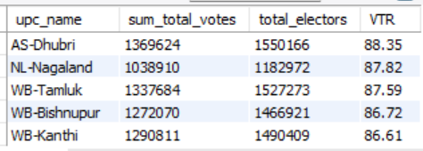
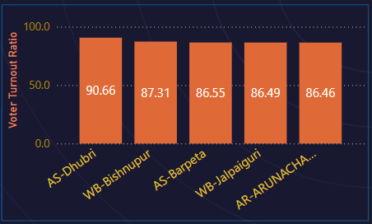
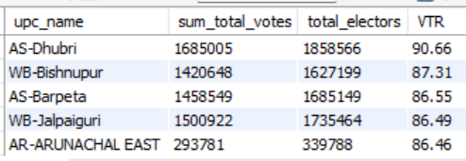
Q1 : Top 5 constituencies of 2014 & 2019 in terms of voter turn out ratio
2014
2019
Insights : Constituencies from North eastern states dominate the list, Assam’s Dhubri constituency being the highest for both the elections.

Slide 6
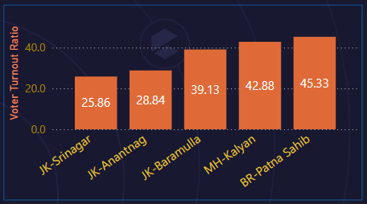
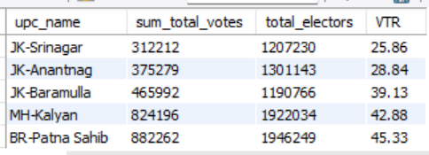
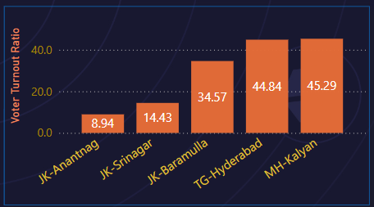
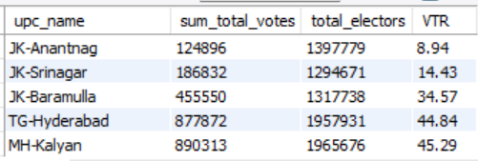
Q1 : Bottom 5 constituencies of 2014 & 2019 in terms of voter turn out ratio
2014
2019
Insights : Jammu & Kashmir with the lowest VTR ; reasons being Security issues, political instability, boycotts, etc.

Slide 7
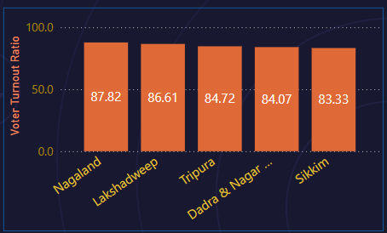
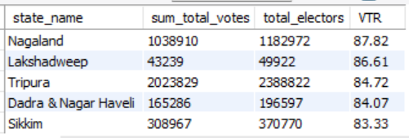
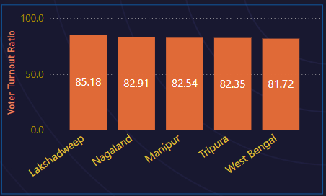
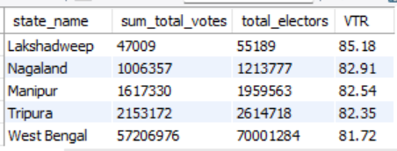
Q2 : Top 5 states of 2014 & 2019 by voter turn out ratio
2014
2019
Insights : North eastern states dominate the list reason being less population, cultural importance, efforts by political parties.

Slide 8
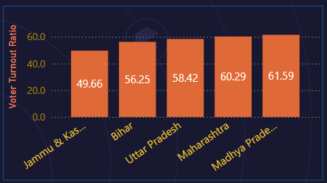
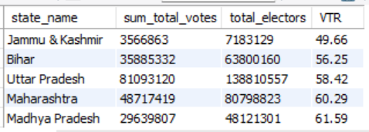
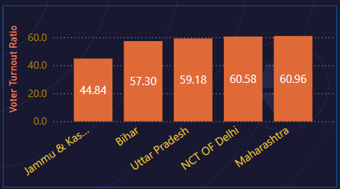
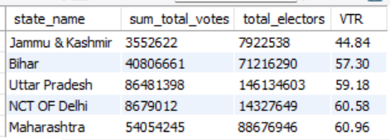
Q2 : Bottom 5 states of 2014 & 2019 by voter turn out ratio
2014
2019
Insights : J & K due to security concerns etc and UP, Bihar due to migrant workers, socio-economic barriers etc.

Slide 9
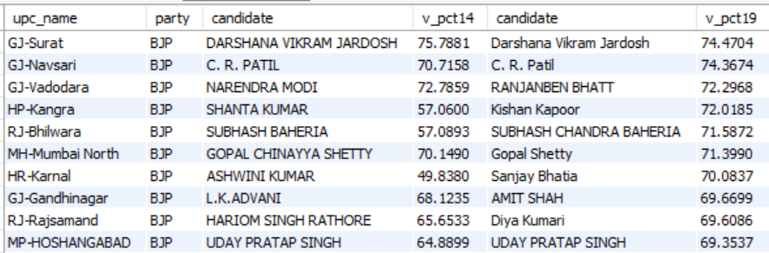
Q3 : which constituencies have elected the same party for two consecutive elections, rank them by % of votes to that winning party in 2019.
Insights : Half of constituencies are from Gujrat which is BJP’s forte

Slide 10
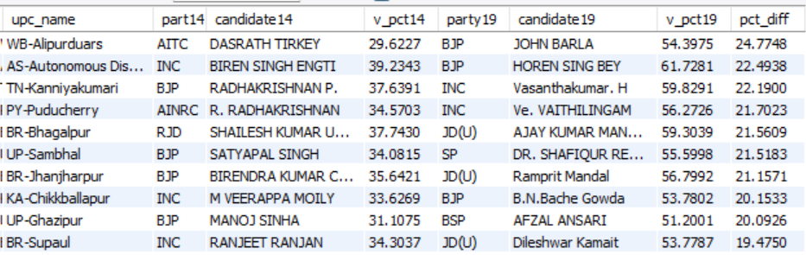
Q4 : Which constituencies have voted for different parties in 2 elections (list top 10 based on difference(2019-2014) in winner vote percentage in 2 elections)
Insights : Probably affected by local issues, candidate’s performance and appeal

Slide 11
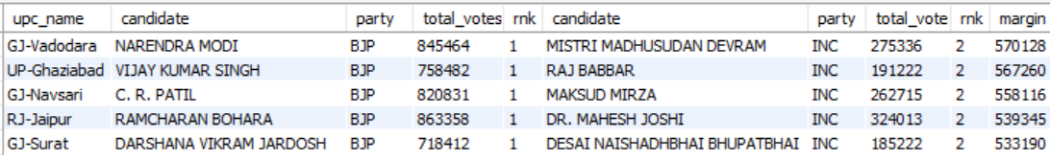
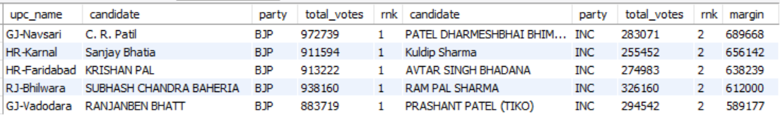
Q5 : Top 5 candidates based on margin difference with runners in 2014 & 2019
2014
2019
Insights : All the winning candidates are from BJP showing BJP’s strong hold on these PCs.

Slide 12
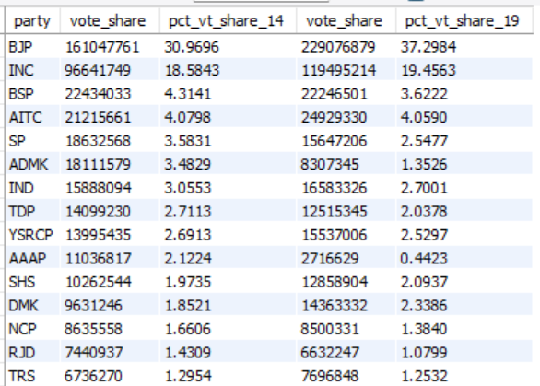
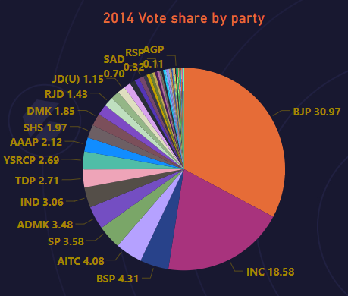
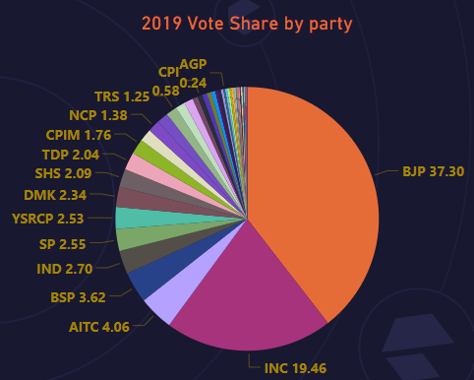
Q6 : Percentage split of votes of parties between 2014 vs 2019 at national level
Insights : BJP’s vote share increased by 6% and INC’s vote share increased by 1%.
Few regional parties lost vote share in 2019 compared to 2014

Slide 13

Q7 : Percentage split of votes of parties between 2014 vs 2019 at state level

Slide 14
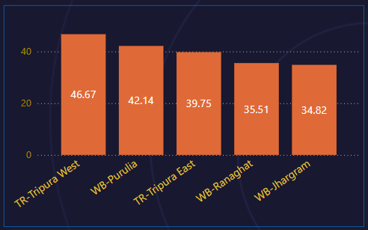
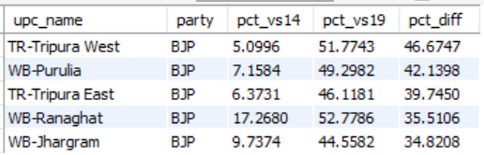
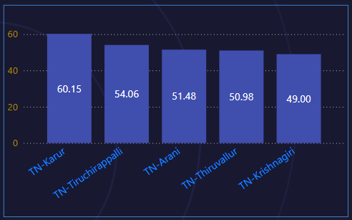
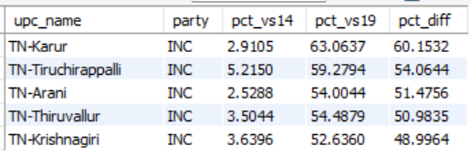
Q8 : Top 5 constituencies for 2 major national parties where they have gained vote share in 2019 as compared to 2014
For BJP
For INC
Insights : Both BJP & INC had alliance with regional parties , anti-incumbency is also a factor.

Slide 15
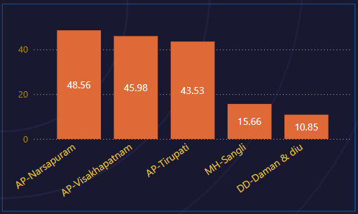
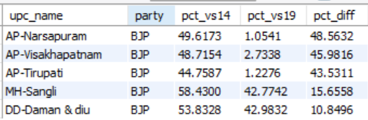
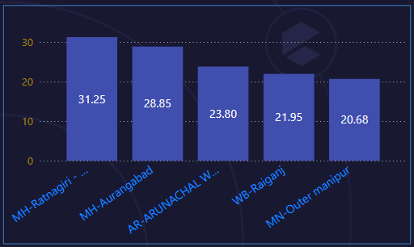
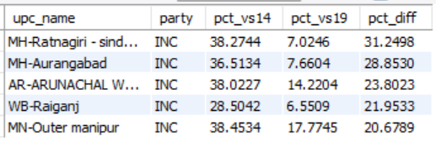
Q9 : Top 5 constituencies for 2 major national parties where they have lost vote share in 2019 as compared to 2014
For BJP
For INC
Insights : Factors like alliance, candidates switching parties, anti-incumbency play a major role.

Slide 16
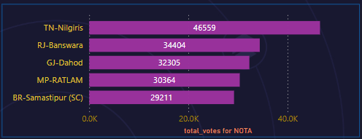
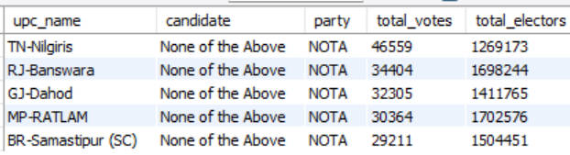
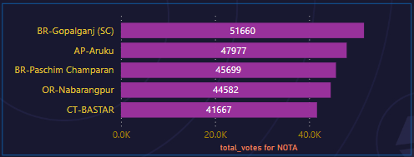
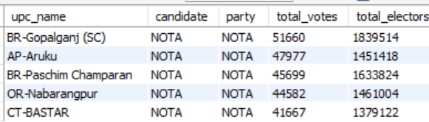
Q10. Which constituency voted the most for NOTA ?
2014
2019
For 2014, Tamil Nadu's Nilgiris voted the most for NOTA with 46559 votes
For 2019, Bihar’s Gopalganj voted the most for NOTA with 51660 votes

Slide 17
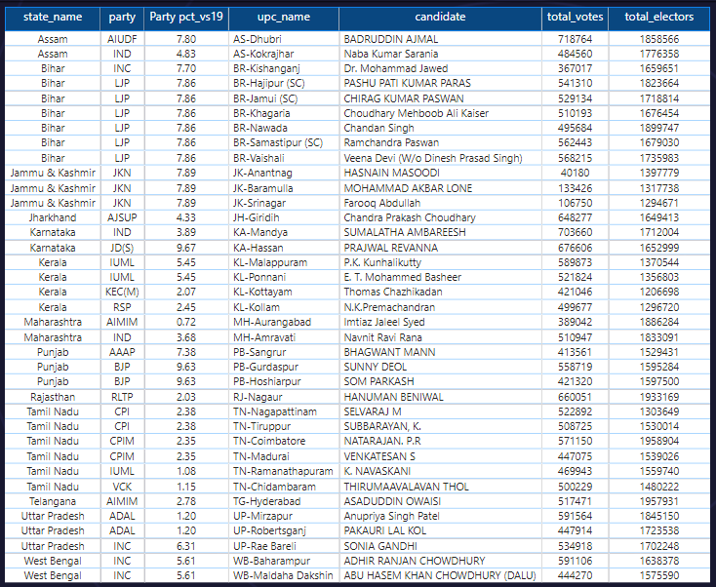
Q11 : Which constituencies have elected candidates whose party has less than 10% vote share at state level in 2019

Slide 18
Correlation between GDP, Literacy% of a state & Voter turnout %
Weak Correlation (0.139)
Moderate Negative Correlation (-0.437)
No clear trend observed, the voter turnout ratio has instances of both high and low values across a similar range of literacy percentages.
As GDP increases, the voter turnout tends to decrease, and vice versa, to a moderate extent.

Slide 19
Correlation between Postal votes% & Voter turnout % by state
Weak Correlation (0.1652)
Weak Correlation (0.0730 )
There is no linear relationship between postal votes and voter turnout percentages for both 2014 and 2019.

Slide 20
Recommendations for increasing voter turn out
Voter Education and Awareness
Incentives and Recognition
Awareness at college & university level

Slide 21


Thank you

